Slide 1

Software Engineering for Quadcopter Control
Vrushank Agrawal

Slide 2
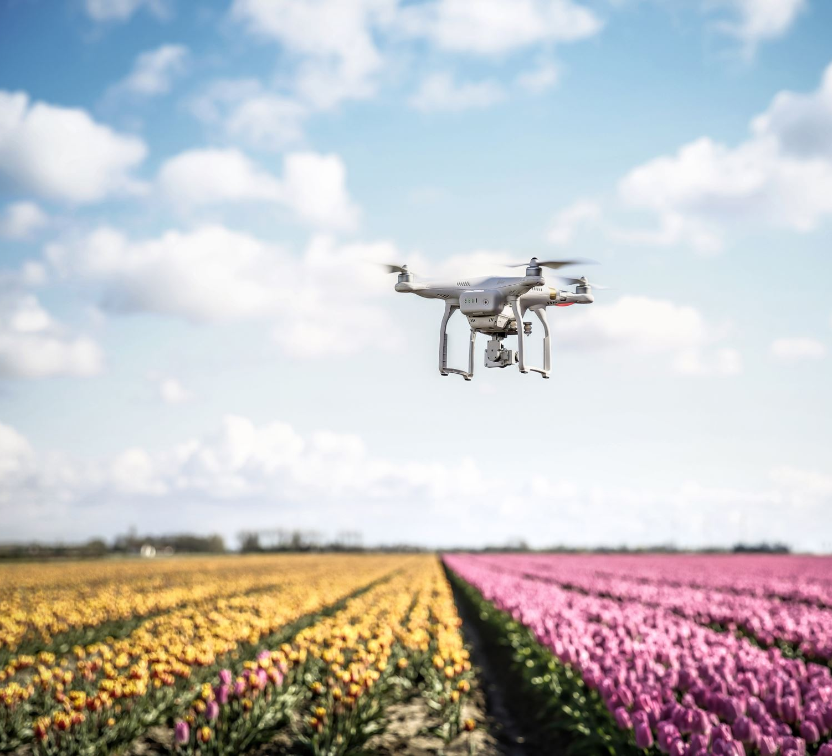
Introduction
2
Quadcopter
Unmanned Aerial Vehicle and a type of drone
Embedded System
Feedback control loop
Analyzes current set point
Send controlled signals to motors to reach desired set point

Slide 3
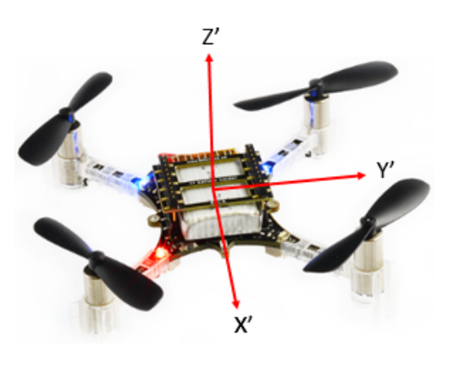
Quadcopter Movement
3
6 Degrees of Freedom (DOF)
4 State Variables
Roll (x)
Pitch (y)
Yaw (z)
Thrust (z – transitional)

Slide 4
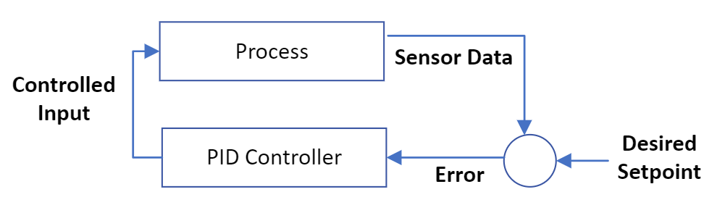
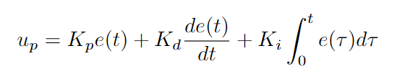
Control Algorithms
4
INDI, Mellinger, PID
PID – Standard and widely used
Applies controlled correction to Error
Input – error(sensors data–desired setpoint)
Output – Controlled input

Slide 5
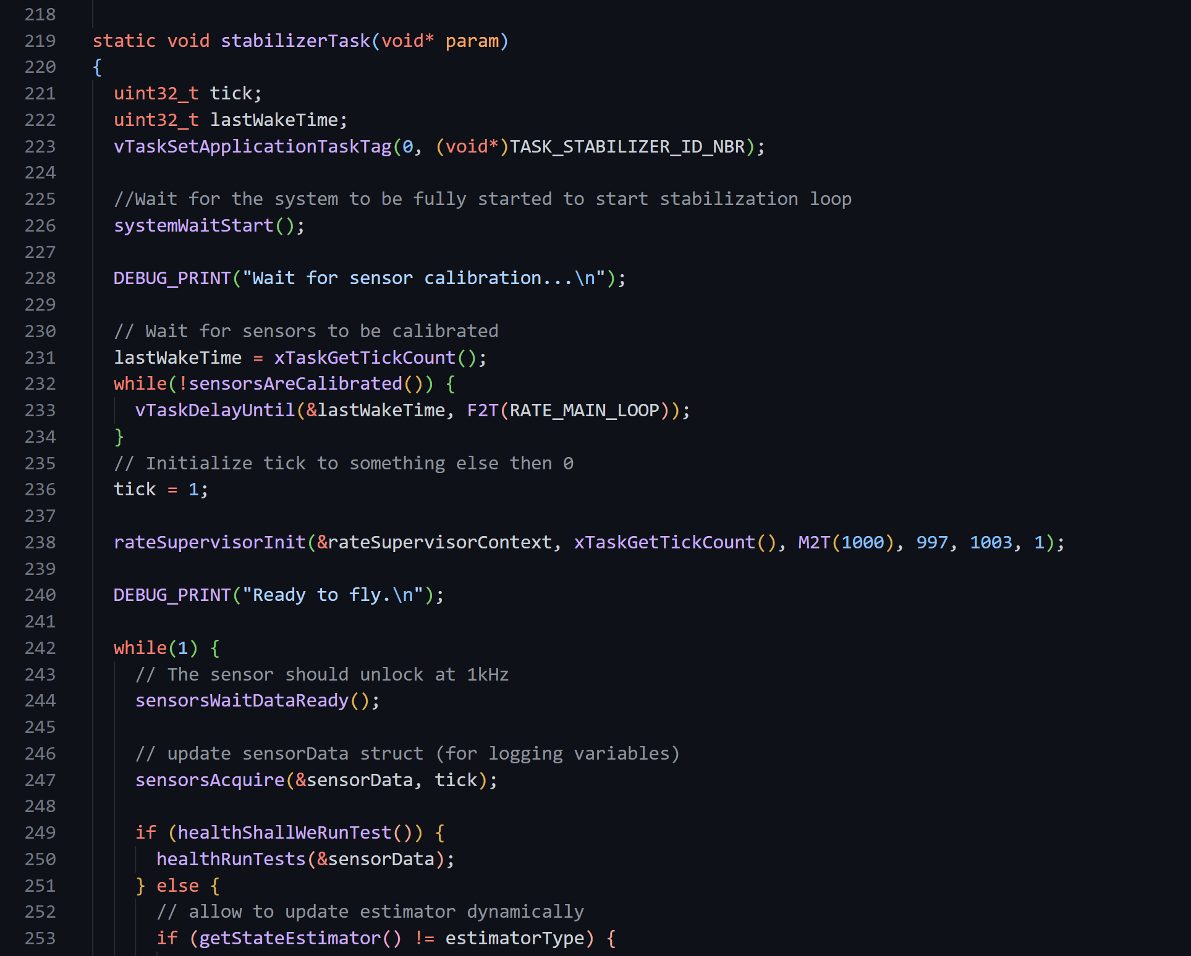
Problem
5
Quadcopters written in complex languages like C/C++
Hard to read, understand, and model reactive behavior

Slide 6
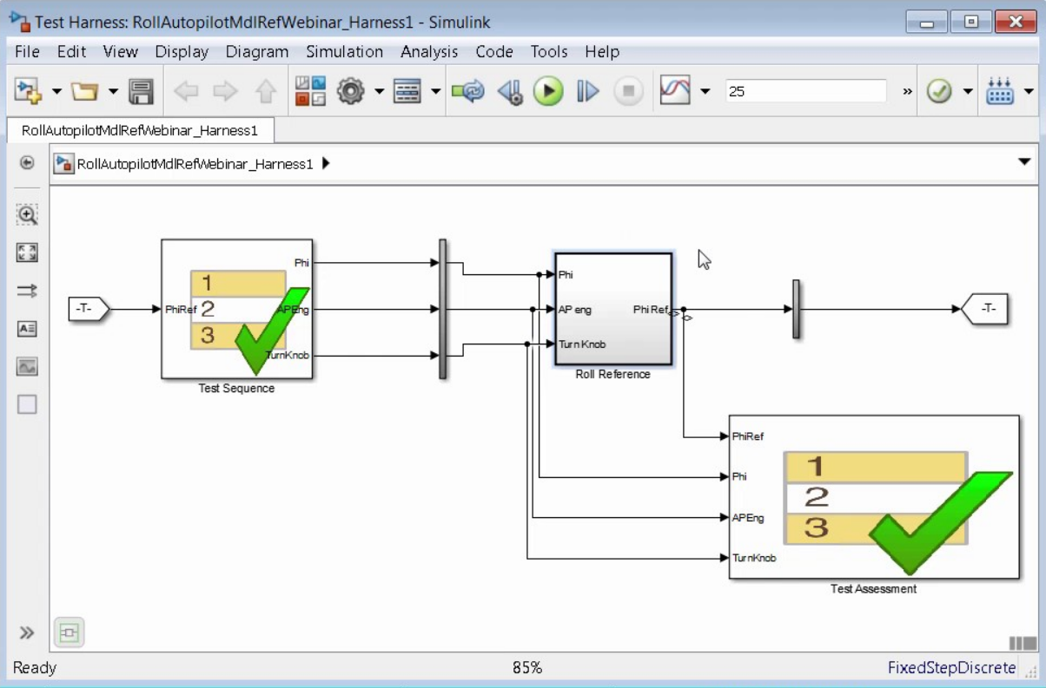
6
Possible solution
Reimplement the code in a Dataflow Synchronous Language
Simpler to model reactive behavior
First Step:
Analyze Control Loop for potential implementation in Lustre

Slide 7
Crazyflie 2.1
7
Built for education and research purposes
Assumption
Crazyflie control loop divided into FreeRTOS tasks
FreeRTOS
Real-time operating system for the microcontroller (Arm Cortex-M4)
Task
An individual action handled by the operating system’s scheduler

Slide 8
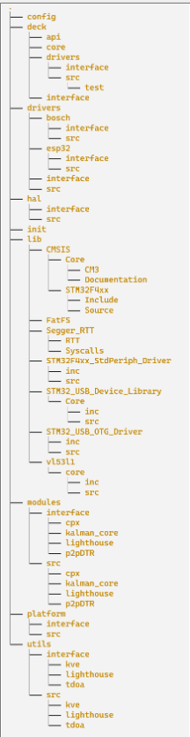
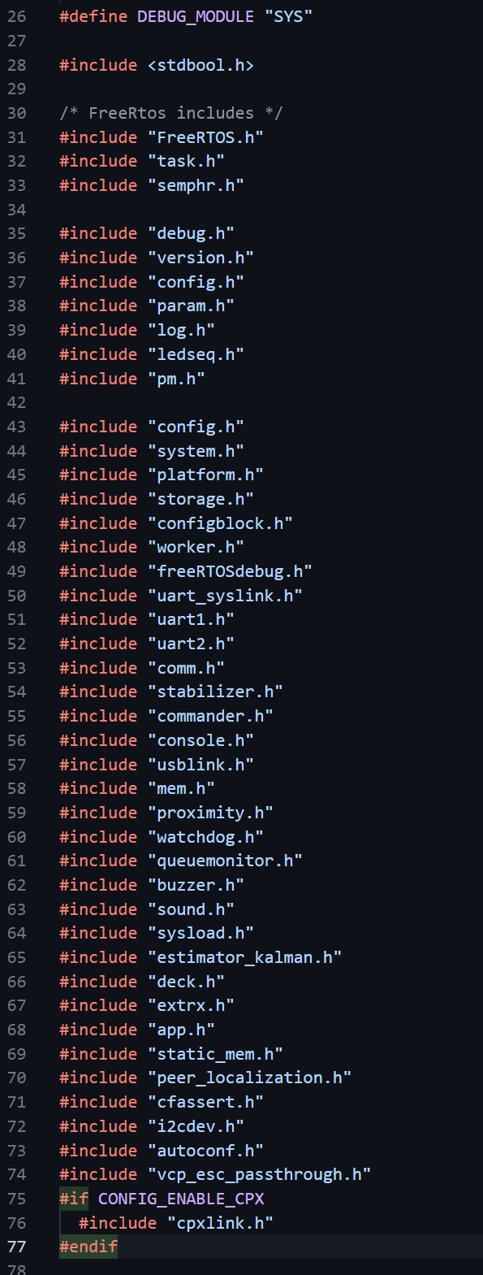
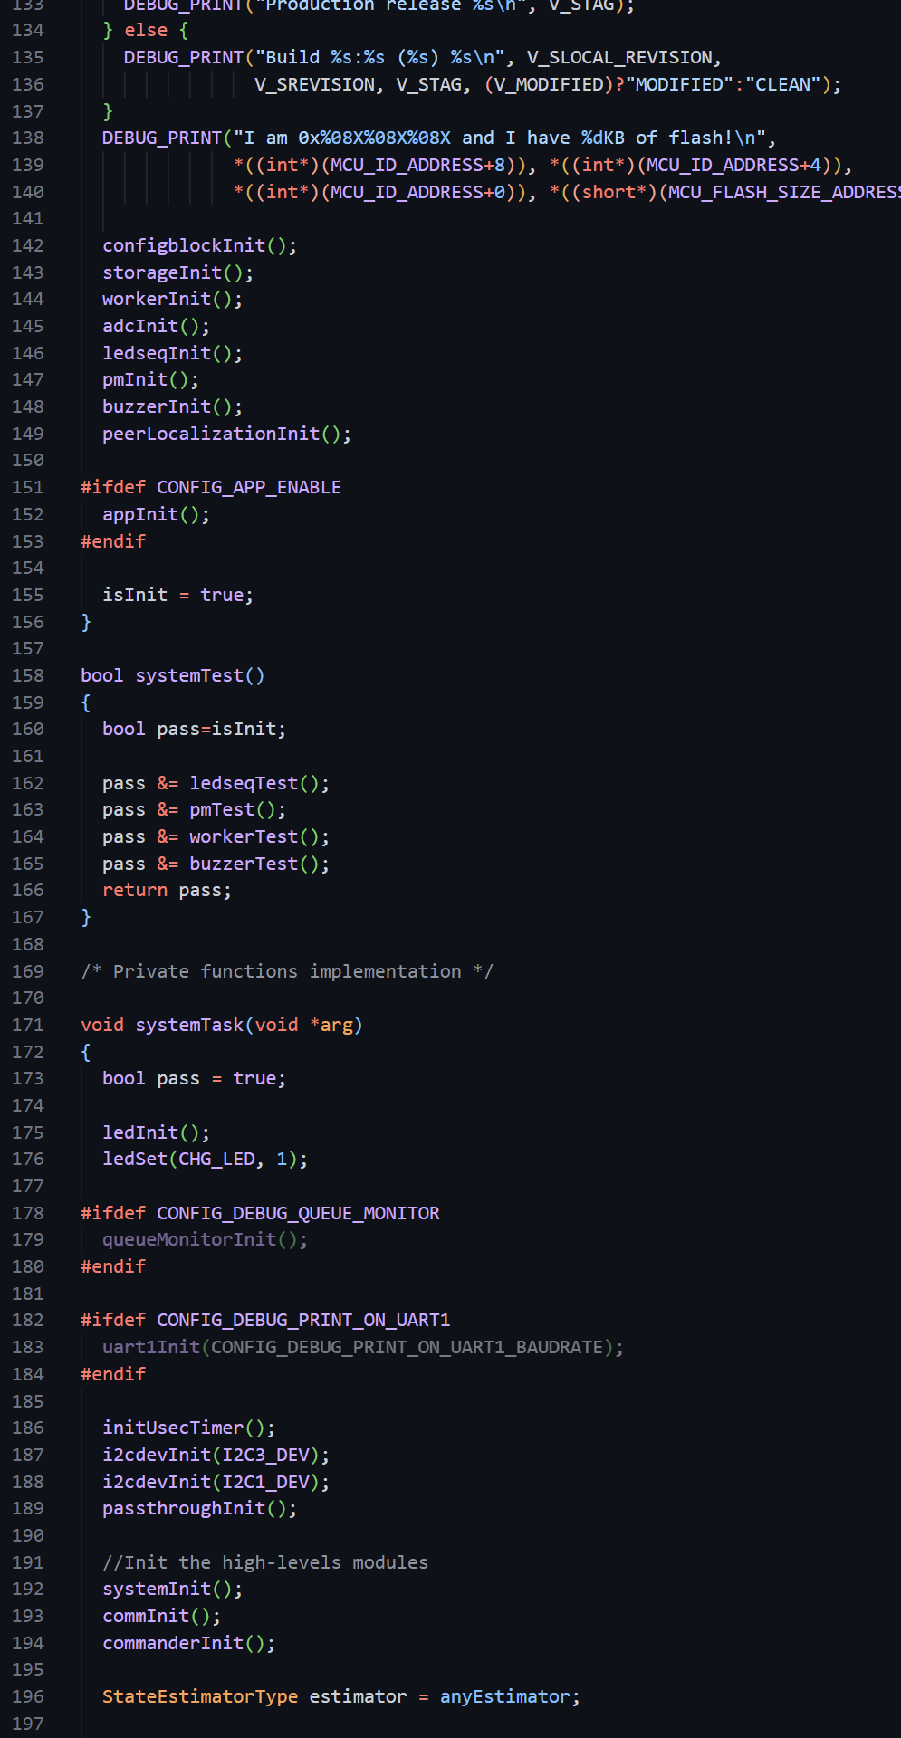
Source Code
8
https://github.com/bitcraze/crazyflie-firmware/
> 1000 files
> 375,000 lines of C code
/src/modules/src main quadcopter code directory
CScope and CTags

Slide 9
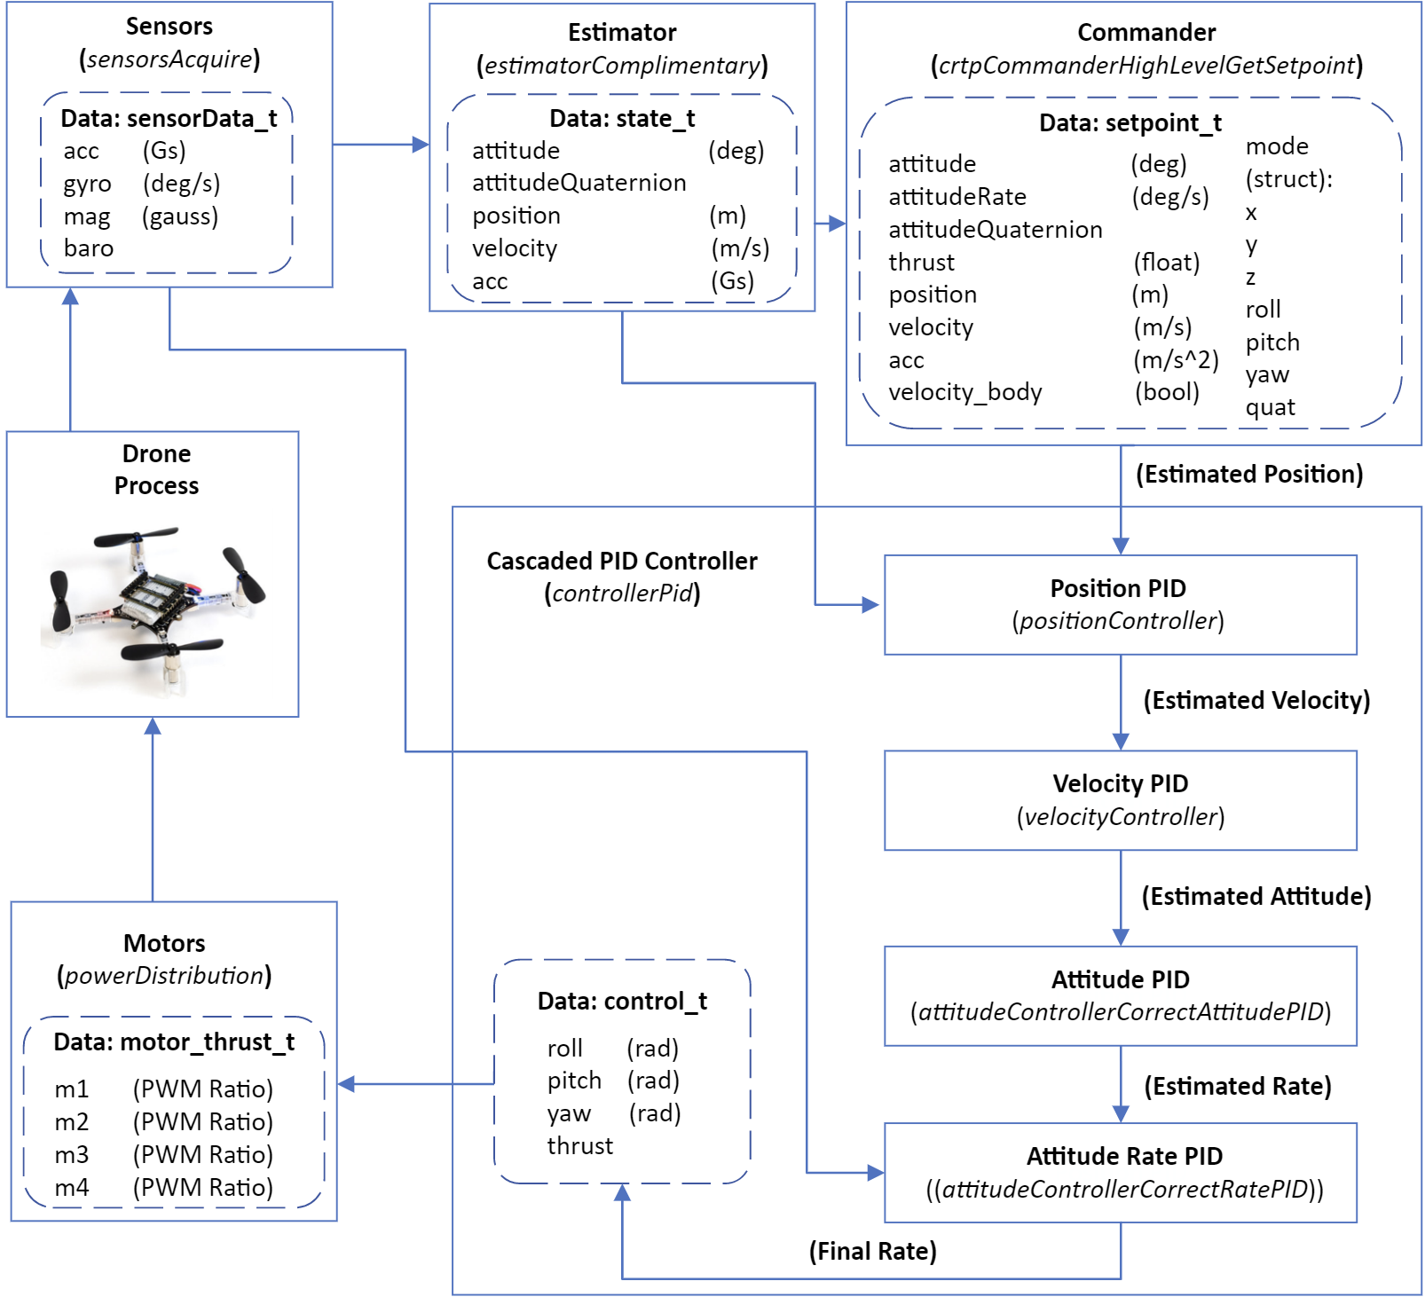
Control Loop Dataflow
9
Sensors
Estimator
Commander
Controller
Motors
Main Drone Process

Slide 10
Conclusion
10
Assumption Wrong
FreeRTOS tasks for decks and Led none for control loop
Control loop is simple, single, linear task
Dataflow representable as a block diagram
Further Steps
Promising first target for implementation in a dataflow synchronous language like Lustre

Slide 11
References
11
Bitcraze, ”Crazyflie 2.1”, bitcraze.io:, https://www.bitcraze.io/products/crazyflie-2-1/. Accessed 28 November 2022.
Quan, Quan. Introduction to Multicopter Design and Control. Springer Singapore, 2017. 1. pp.7-10
Manimaraboopathy, M. & Christopher, H. & Vignesh, S. & selvan, P.. (2017). Unmanned Fire Extinguisher Using Quadcopter. International Journal on Smart Sensing and Intelligent Systems. 2017. 471-481. 10.21307/ijssis-2017-264.
Smeur, Ewoud & Chu, Q.P. & Croon, Guido. (2015). Adaptive Incremental Nonlinear Dynamic Inversion for Attitude Control of Micro Air Vehicles. Journal of Guidance, Control, and Dynamics. 39. 1-12. 10.2514/1.G001490
Mellinger, Daniel et al. “Trajectory generation and control for precise aggressive maneuvers with quadrotors.” The International Journal of Robotics Research 31 (2010): 664 - 674
FreeRTOS, ”Tasks and Co-routines”, freertos.org:, https://www.freertos.org/taskandcr.html. Accessed 29 November 2022
Github, ”bitcraze/crazyflie-firmware”, github.com, https://github.com/bitcraze/crazyflie-firmware/ Accessed 29 November 2022.

Slide 12
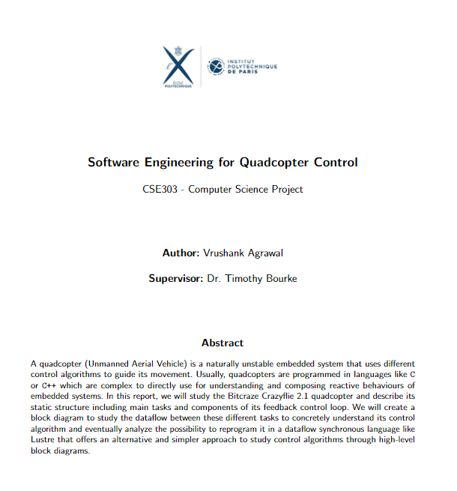
Thank You

